Slide 1
Linear Algebra – Distance, Hyperplanes and Halfspaces, Eigenvalues, Eigenvectors

Slide 2
Review
So far we have discussed linear algebra and matrix theory from a data science perspective
We will provide some geometric interpretations now
This section covers the following
Vectors
Notion of distance
Projections
Hyperplanes
Halfspaces
Eigenvalues and eigenvectors

Slide 3
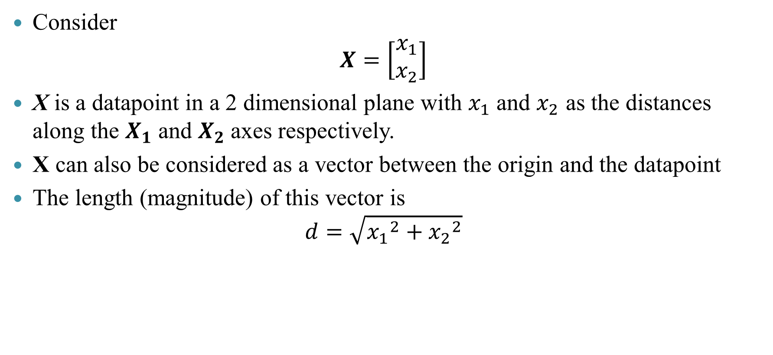
Vectors and lengths
Consider
$$X=\left[\begin{aligned}x_{1} \\ x_{2}\end{aligned}\right]$$
X is a datapoint in a 2 dimensional plane with $x_{1}$ and $x_{2}$ as the distances along the $X_{1}$ and $X_{2}$axes respectively.
X can also be considered as a vector between the origin and the datapoint
The length (magnitude) of this vector is
$$d=\sqrt{{x_{1}}^{2}+{x_{2}}^{2}}$$

Slide 4
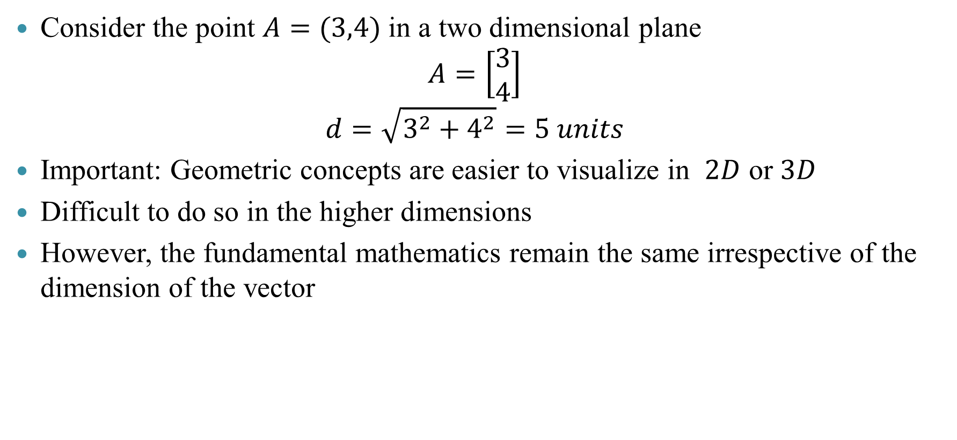
Vectors and lengths: Example
Consider the point $A=(3,4)$ in a two dimensional plane
$$A=\left[\begin{aligned}3 \\ 4\end{aligned}\right]$$
$$d=\sqrt{3^{2}+4^{2}}=5 units$$
Important: Geometric concepts are easier to visualize in $2D$ or $3D$
Difficult to do so in the higher dimensions
However, the fundamental mathematics remain the same irrespective of the dimension of the vector

Slide 5
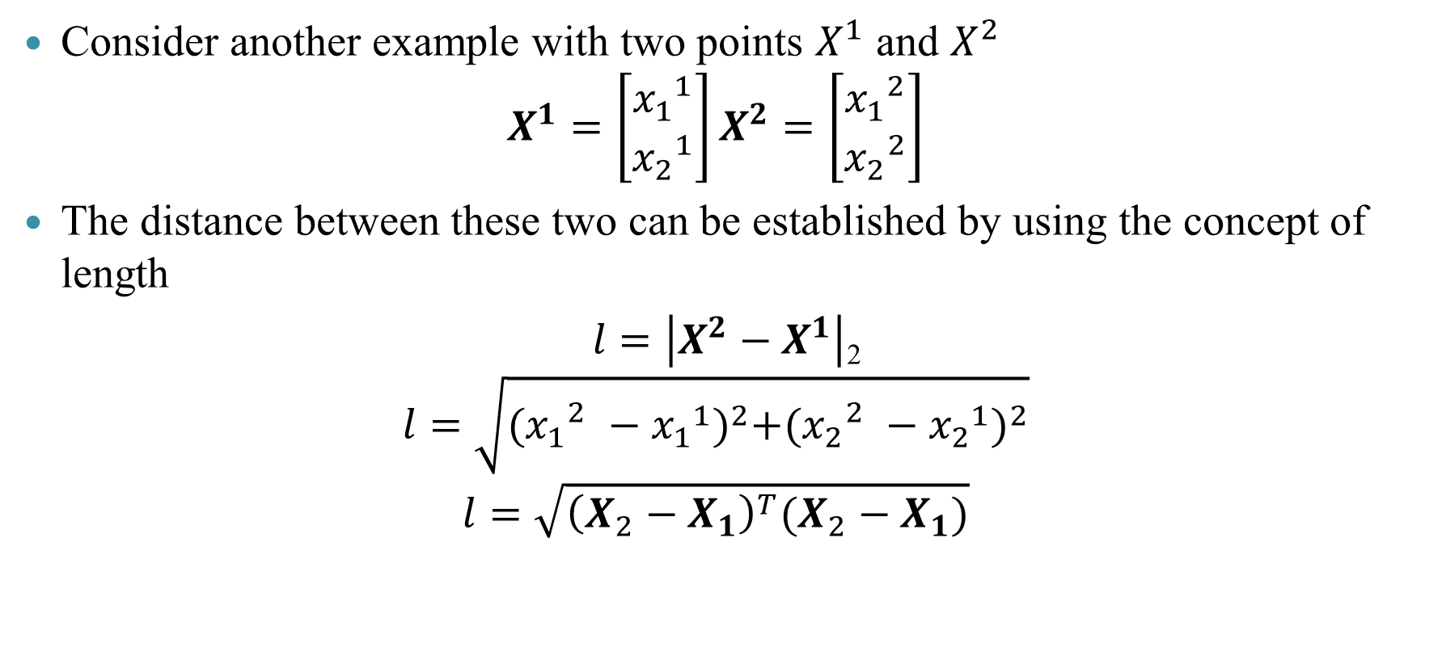
Vectors and distances
Consider another example with two points $X^{1}$ and $X^{2}$
$$X^{1}=\left[\begin{aligned}{x_{1}}^{1} \\ {x_{2}}^{1}\end{aligned}\right]X^{2}=\left[\begin{aligned}{x_{1}}^{2} \\ {x_{2}}^{2}\end{aligned}\right]$$
The distance between these two can be established by using the concept of length
$l=\left|X^{2}−X^{1}\right|$₂
$$l=\sqrt{{({x_{1}}_{}^{2}−{x_{1}}^{1})}^{2}+{({x_{2}}_{}^{2}−{x_{2}}^{1})}^{2}}$$
$$l=\sqrt{{\left(X_{2}−X_{1}\right)}^{T}(X_{2}−X_{1})}$$

Slide 6
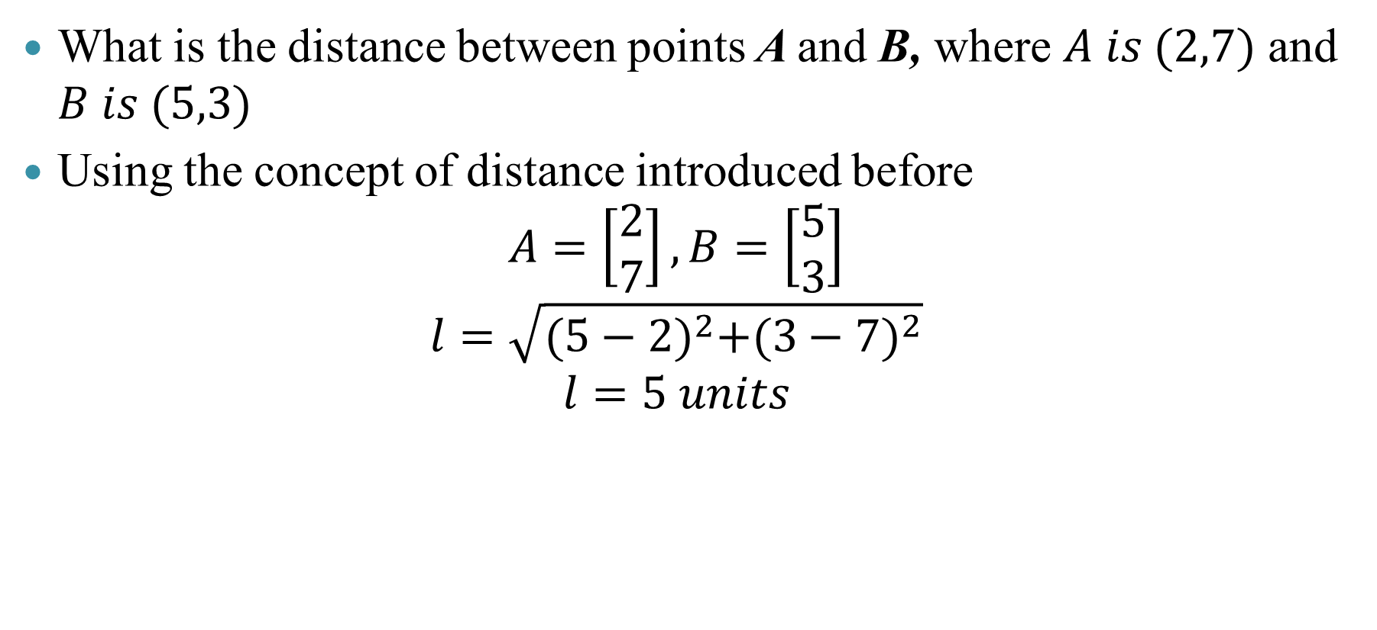
Vectors and distances: Example
What is the distance between points A and B, where $A is (2,7)$ and $B is (5,3)$
Using the concept of distance introduced before
$$A=\left[\begin{aligned}2 \\ 7\end{aligned}\right], B=\left[\begin{aligned}5 \\ 3\end{aligned}\right]$$
$$l=\sqrt{{(5−2)}^{2}+{(3−7)}^{2}}$$
$$l=5 units$$

Slide 7
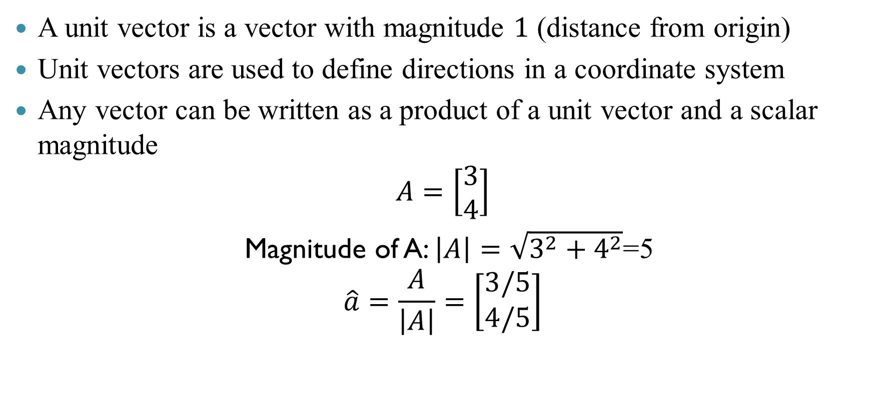
Unit vector
A unit vector is a vector with magnitude $1$ (distance from origin)
Unit vectors are used to define directions in a coordinate system
Any vector can be written as a product of a unit vector and a scalar magnitude
$$A=\left[\begin{aligned}3 \\ 4\end{aligned}\right]$$
Magnitude of A: $\left|A\right|=\sqrt{3^{2}+4^{2}}$=5
$$\hat{a}=\frac{A}{\left|A\right|}=\left[\begin{aligned}3/5 \\ 4/5\end{aligned}\right]$$

Slide 8
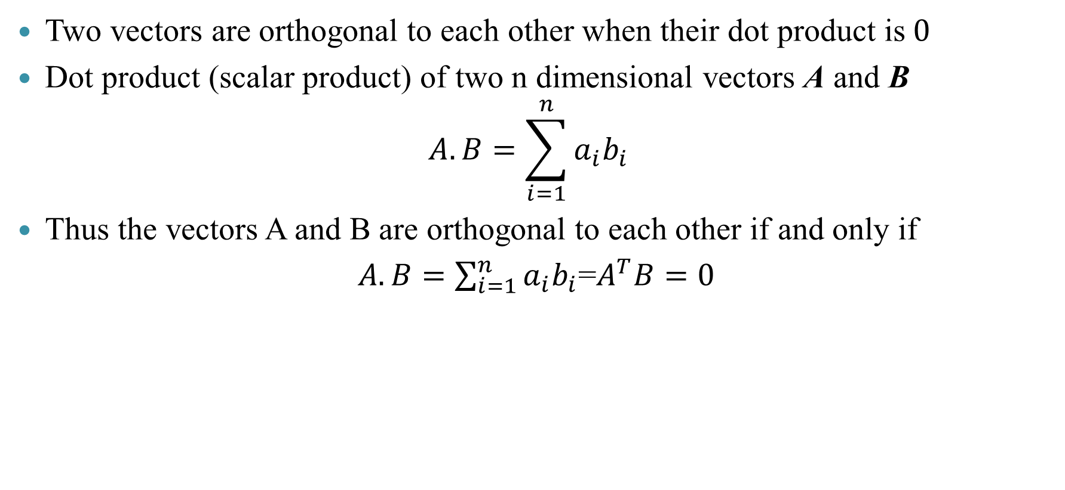
Orthogonal vectors
Two vectors are orthogonal to each other when their dot product is$0$
Dot product (scalar product) of two n dimensional vectors A and B
$$A.B=\sum_{i=1}^{n}{a_{i}b_{i}}$$
Thus the vectors A and B are orthogonal to each other if and only if
$A.B=\sum_{i=1}^{n}{a_{i}b_{i}}$=$A^{T}B=0$

Slide 9
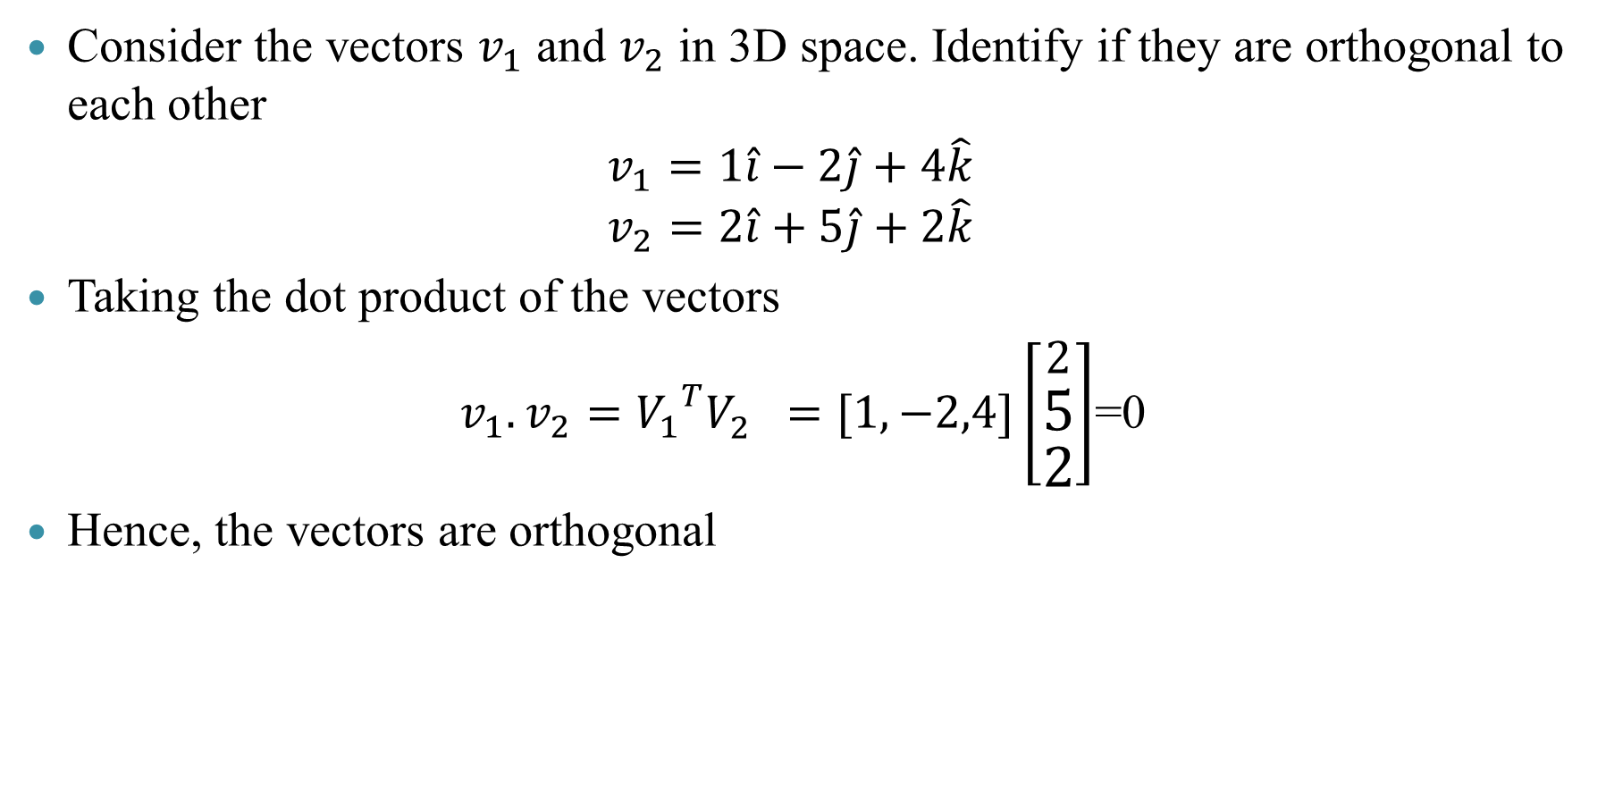
Orthogonal vectors: Example
Consider the vectors $v_{1}$ and $v_{2}$ in 3D space. Identify if they are orthogonal to each other
$$v_{1}=1\hat{i}−2\hat{j}+4\hat{k}$$
$$v_{2}=2\hat{i}+5\hat{j}+2\hat{k}$$
Taking the dot product of the vectors
$v_{1}.v_{2}={V_{1}}^{T}V_{2}^{}=[1,−2,4]\left[\begin{aligned}2 \\ 5 \\ 2\end{aligned}\right]$=0
Hence, the vectors are orthogonal
R Code
v1=c(1,-2,4)
v2=c(2,5,2)
N=t(v1)%*%v2
Console Output
> N
[,1]
[1,] 0

Slide 10
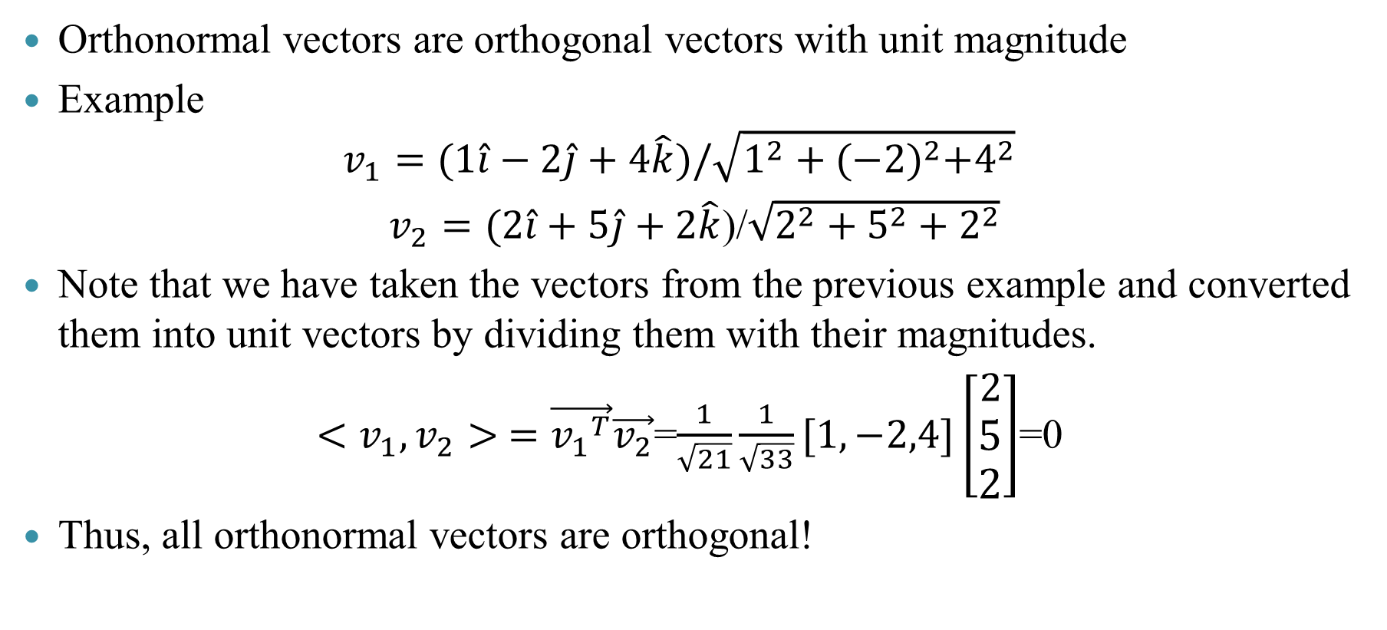
Orthonormal vectors
Orthonormal vectors are orthogonal vectors with unit magnitude
Example
$$v_{1}=(1\hat{i}−2\hat{j}+4\hat{k})/\sqrt{1^{2}+{(−2)}^{2}+4^{2}}$$
$v_{2}=(2\hat{i}+5\hat{j}+2\hat{k}$)/$\sqrt{2^{2}+5^{2}+2^{2}}$
Note that we have taken the vectors from the previous example and converted them into unit vectors by dividing them with their magnitudes.
$<v_{1},v_{2}> =\vec{{v_{1}}^{T}}\vec{v_{2}}$=$\frac{1}{\sqrt{21}}\frac{1}{\sqrt{33}}[1,−2,4]\left[\begin{aligned}2 \\ 5 \\ 2\end{aligned}\right]$=0
Thus, all orthonormal vectors are orthogonal!

Slide 11
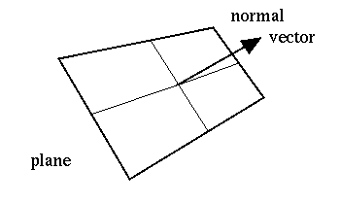
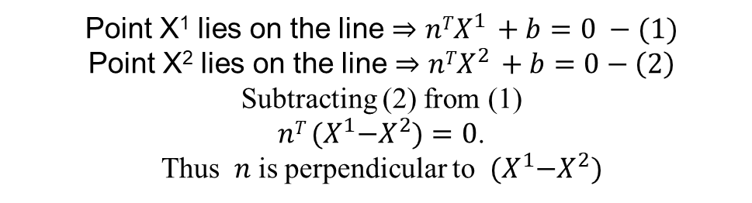



Representation of line and plane
$$n =\left[\begin{matrix}a \\ b\end{matrix}\right]$$
$$ax+by+c=0$$
(${nTX}^{}+b=0$)
Point X¹ lies on the line $⇒{nTX}^{1 }+b=0 −(1)$
Point X² lies on the line $⇒{nTX}^{2 }+b=0−\left(2\right)$
Subtracting (2) from (1)
$nT {(X}^{1}−X^{2})=0$.
Thus $n$ is perpendicular to ${(X}^{1}−X^{2})$

Slide 12



Projections
We can define the projection ($\hat{X}$) of a vector (X) onto a lower dimension (two dimensions in the picture) mathematically as
${\hat{X}=c}_{1}v_{1}+c_{2}v_{2}$
Using vector addition
$${X=c}_{1}v_{1}+c_{2}v_{2}+n$$
$$v_{2}$$
$$v_{1}$$

Slide 13
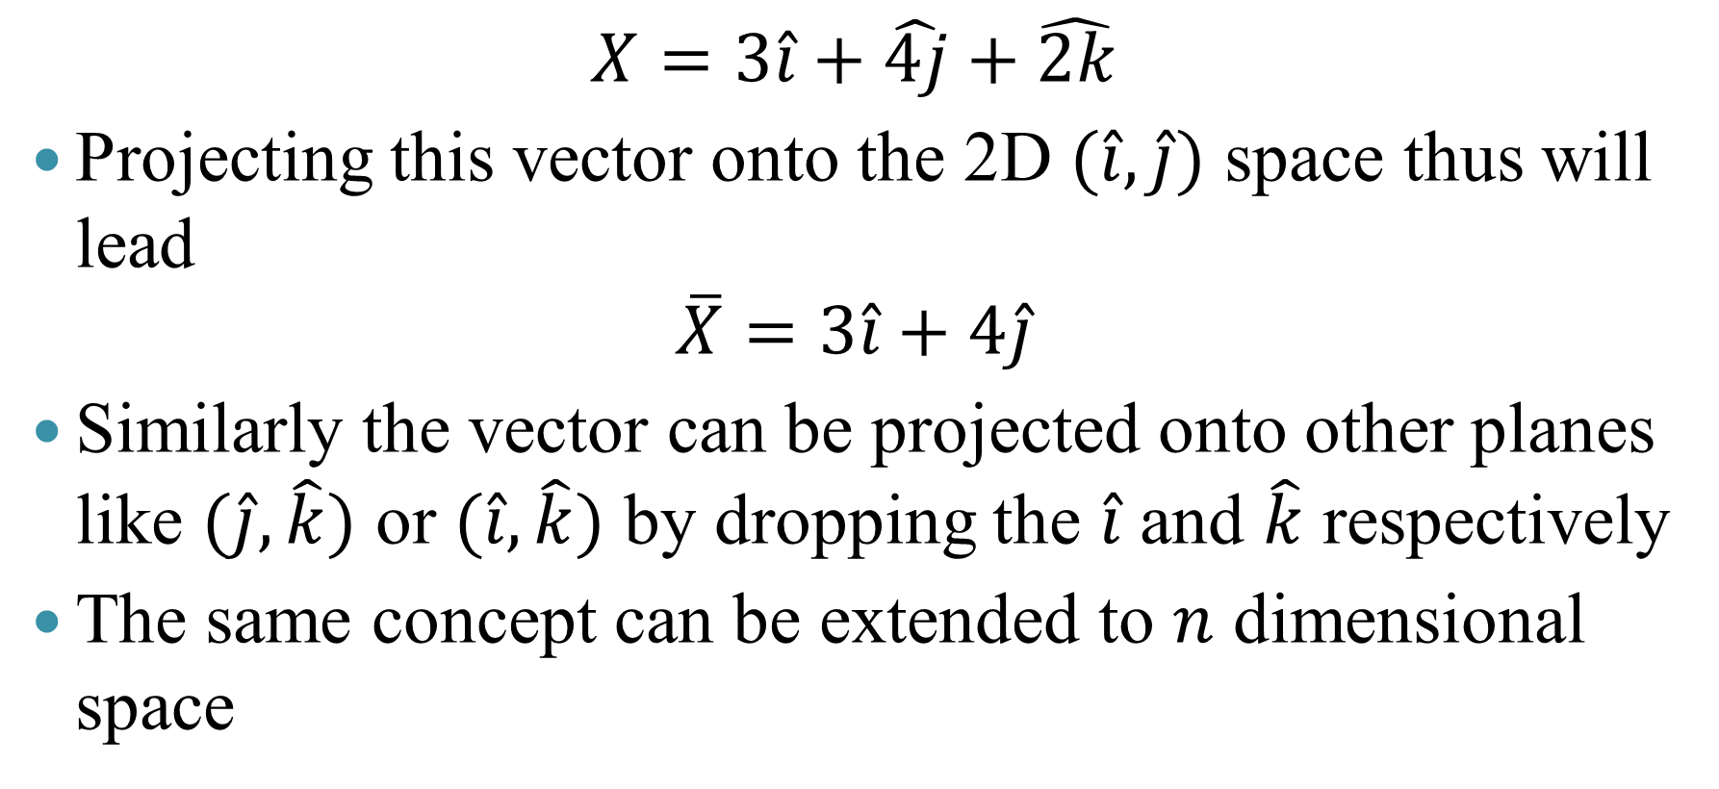
Projections: Example
$$X=3\hat{i}+\hat{4j}+\hat{2k}$$
Projecting this vector onto the 2D $(\hat{i},\hat{j})$ space thus will lead
$$\overline{X}=3\hat{i}+4\hat{j}$$
Similarly the vector can be projected onto other planes like $(\hat{j},\hat{k})$ or $(\hat{i},\hat{k})$ by dropping the $\hat{i}$ and $\hat{k}$ respectively
The same concept can be extended to $n$ dimensional space

Slide 14



Projections
Projections onto general directions (two dimensions in this case)
$$\hat{X}=\frac{X^{T}v_{1}}{{v_{1}}^{T}v_{1}^{}}v_{1}+\frac{X^{T}v_{2}}{{v_{2}}^{T}v_{2}^{}}v_{2}$$
$$v_{2}$$
$$v_{1}$$

Slide 15
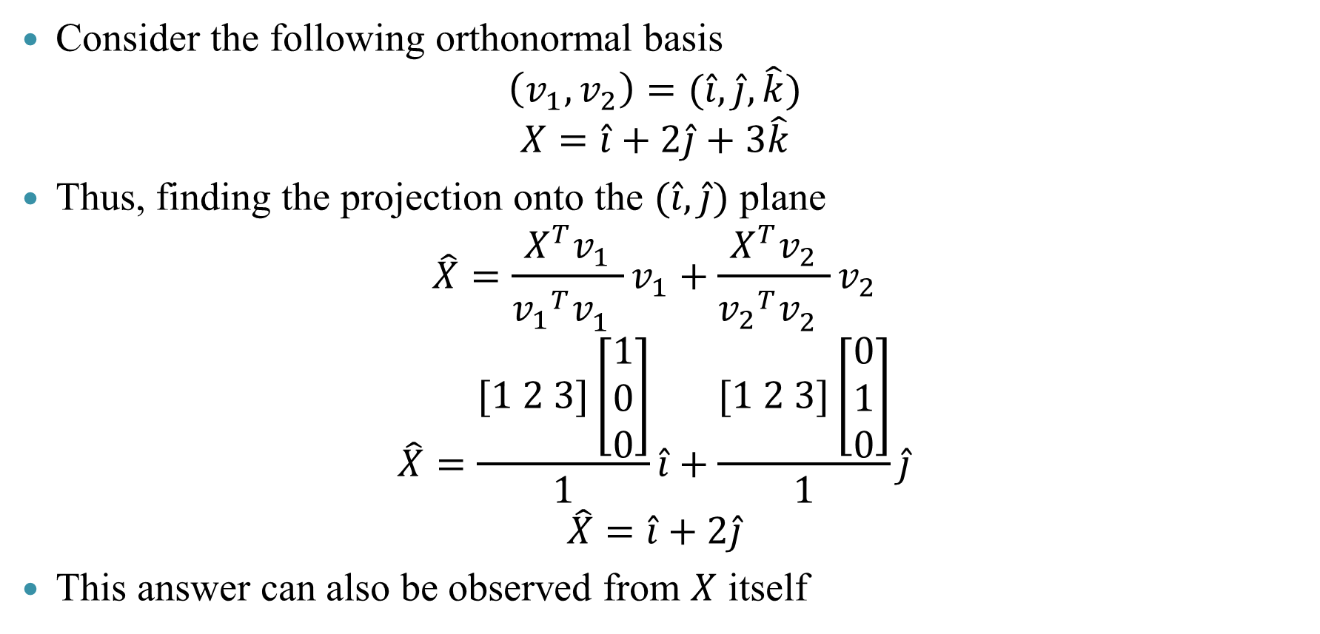
Projections: Example
Consider the following orthonormal basis
$$\left(v_{1},v_{2}\right)=(\hat{i},\hat{j},\hat{k})$$
$$X=\hat{i}+2\hat{j}+3\hat{k}$$
Thus, finding the projection onto the $(\hat{i},\hat{j})$ plane
$$\hat{X}=\frac{X^{T}v_{1}}{{v_{1}}^{T}v_{1}^{}}v_{1}+\frac{X^{T}v_{2}}{{v_{2}}^{T}v_{2}^{}}v_{2}$$
$$\hat{X}=\frac{[1 2 3]\left[\begin{aligned}1 \\ 0 \\ 0\end{aligned}\right]}{1}\hat{i}+\frac{[1 2 3]\left[\begin{aligned}0 \\ 1 \\ 0\end{aligned}\right]}{1}\hat{j}$$
$$\hat{X}=\hat{i}+2\hat{j}$$
This answer can also be observed from $X$ itself

Slide 16

Hyperplanes
Geometrically, hyper-plane is a subspace whose dimension is one less than that of its ambient space.
For instance, the hyper-planes for a 3D space are 2D planes and hyper-planes for a 2D space are 1D lines and so on.
The hyper-plane is usually described by an equation as follows
$$X^{T}n+b=0$$

Slide 17

Halfspace
We can observe that the equation can be evaluated for the two half-spaces
It can be seen that
$$X^{T}n+b=0 ∀ X∈line$$
$X^{T}n+b>0 ∀ X∈subspace in the n direction$ ($X_{3}$)
$X^{T}n+b<0 ∀ X∈subspace in the −n direction$ ($X_{2}$)

Slide 18
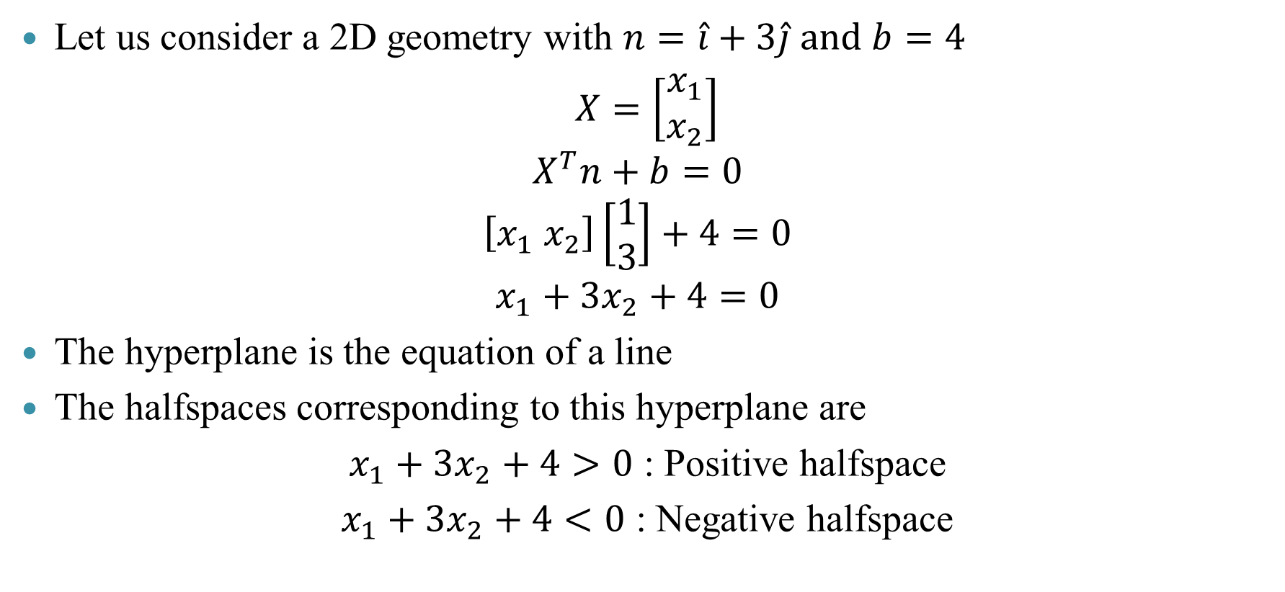
Hyperplanes and halfspaces: Example
Let us consider a 2D geometry with $n=\hat{i}+3\hat{j} and b=4$
$X=\left[\begin{aligned}x_{1} \\ x_{2}\end{aligned}\right]$
$$X^{T}n+b=0$$
$$\left[x_{1} x_{2}\right]\left[\begin{aligned}1 \\ 3\end{aligned}\right]+4=0$$
$$x_{1}+3x_{2}+4=0$$
The hyperplane is the equation of a line
The halfspaces corresponding to this hyperplane are
$x_{1}+3x_{2}+4>0$ : Positive halfspace
$x_{1}+3x_{2}+4<0$ : Negative halfspace

Slide 19
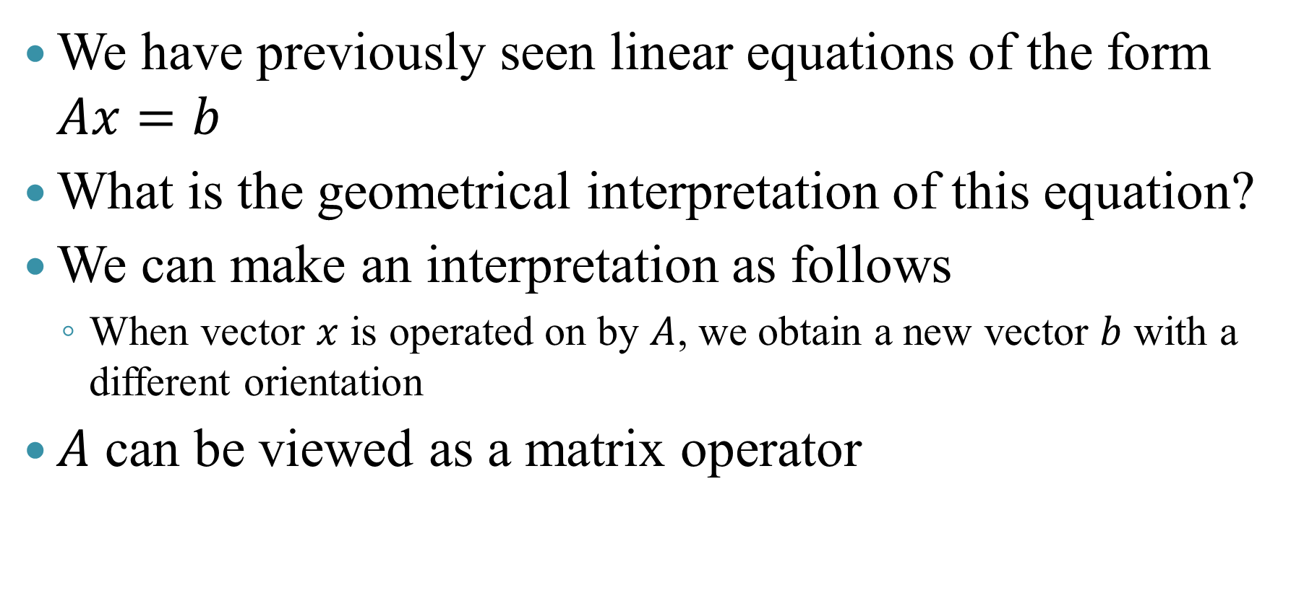
Eigenvalues and eigenvectors
We have previously seen linear equations of the form $Ax=b$
What is the geometrical interpretation of this equation?
We can make an interpretation as follows
When vector $x$ is operated on by $A$, we obtain a new vector $b$ with a different orientation
$A$ can be viewed as a matrix operator

Slide 20
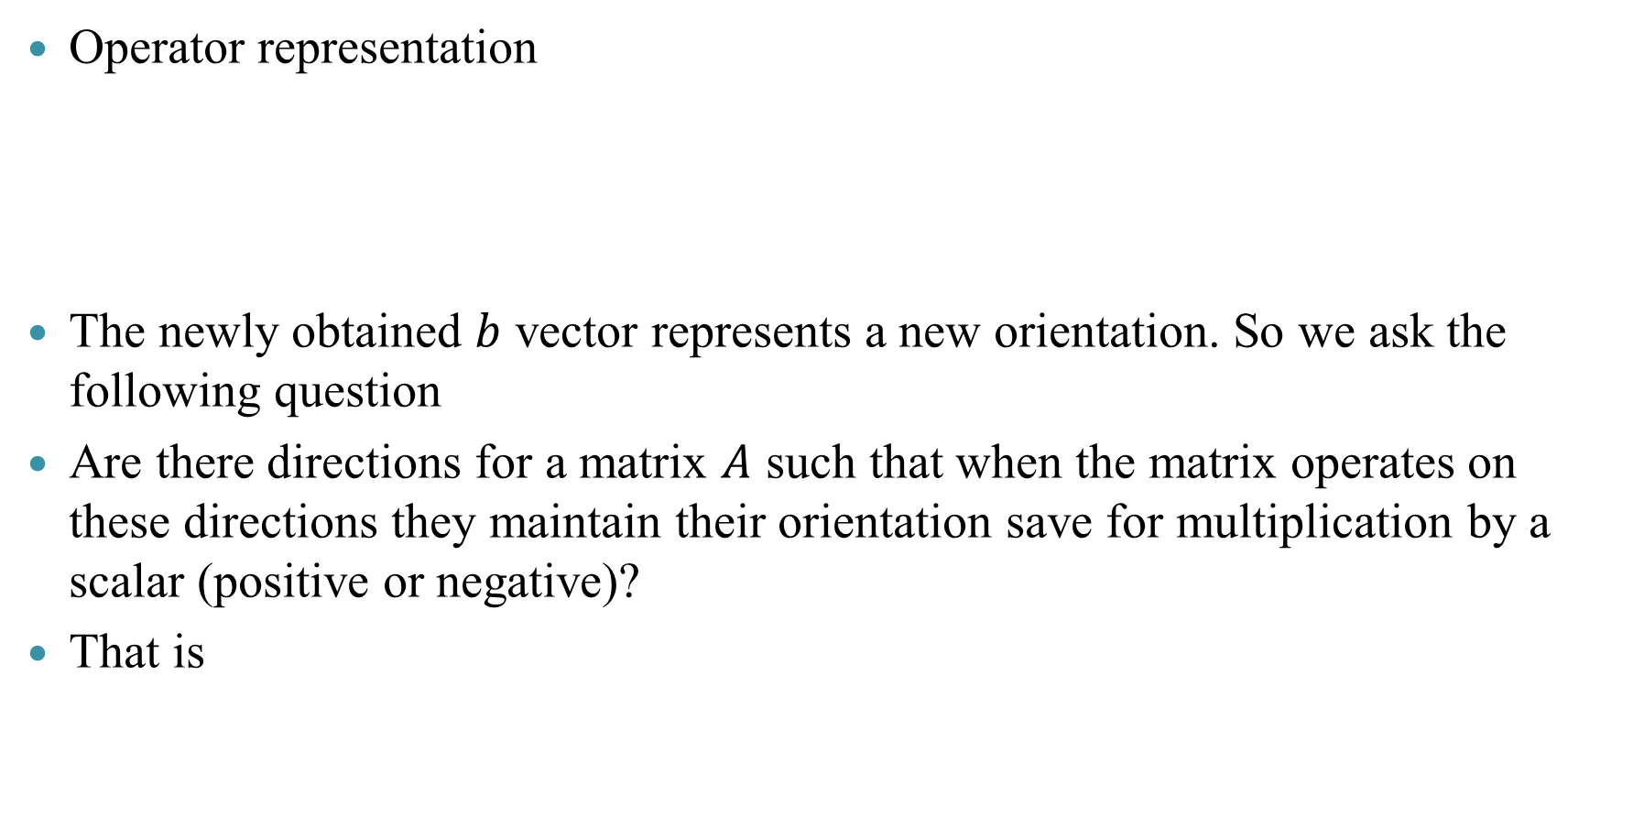
Eigenvalues and eigenvectors
Operator representation
The newly obtained $b$ vector represents a new orientation. So we ask the following question
Are there directions for a matrix $A$ such that when the matrix operates on these directions they maintain their orientation save for multiplication by a scalar (positive or negative)?
That is
x
A
Ax = b
x
A
Ax = b = λx

Slide 21
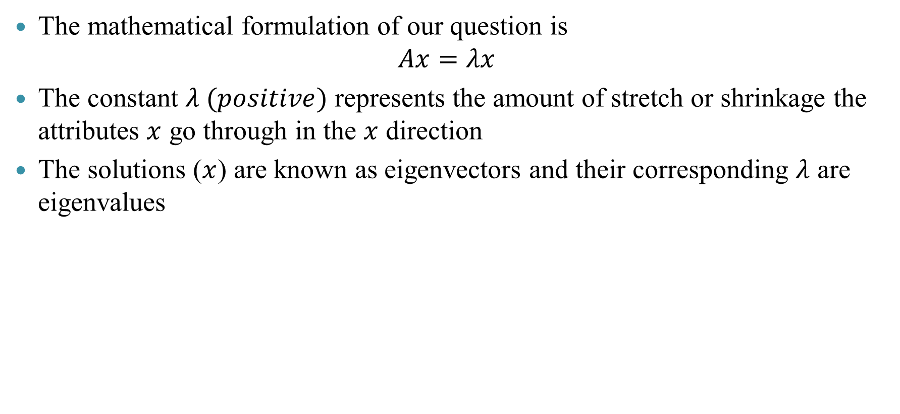
Eigenvalues and eigenvectors
The mathematical formulation of our question is
$$Ax=λx$$
The constant $λ (positive)$ represents the amount of stretch or shrinkage the attributes $x$ go through in the $x$ direction
The solutions ($x$) are known as eigenvectors and their corresponding $λ$ are eigenvalues
y
x
x
λx

Slide 22
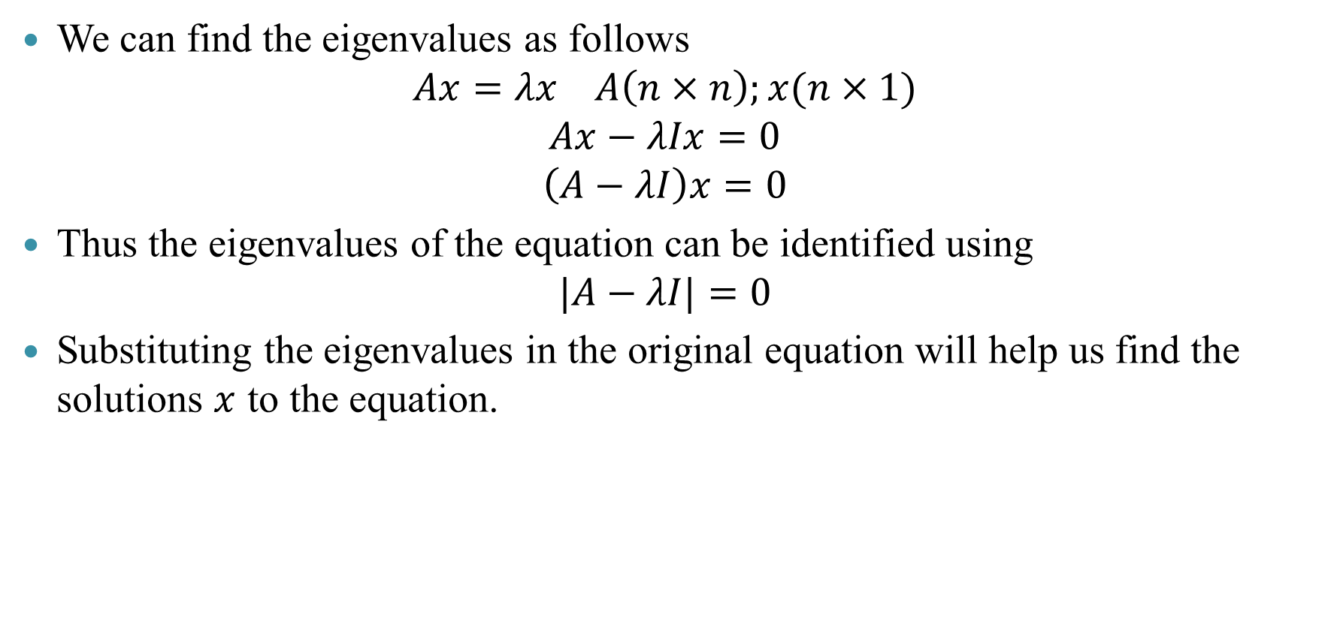
Eigenvalues and eigenvectors
We can find the eigenvalues as follows
$$Ax=λx A\left(n×n\right);x(n×1)$$
$$Ax−λIx=0$$
$$\left(A−λI\right)x=0$$
Thus the eigenvalues of the equation can be identified using
$$|A−λI|=0$$
Substituting the eigenvalues in the original equation will help us find the solutions $x$ to the equation.

Slide 23
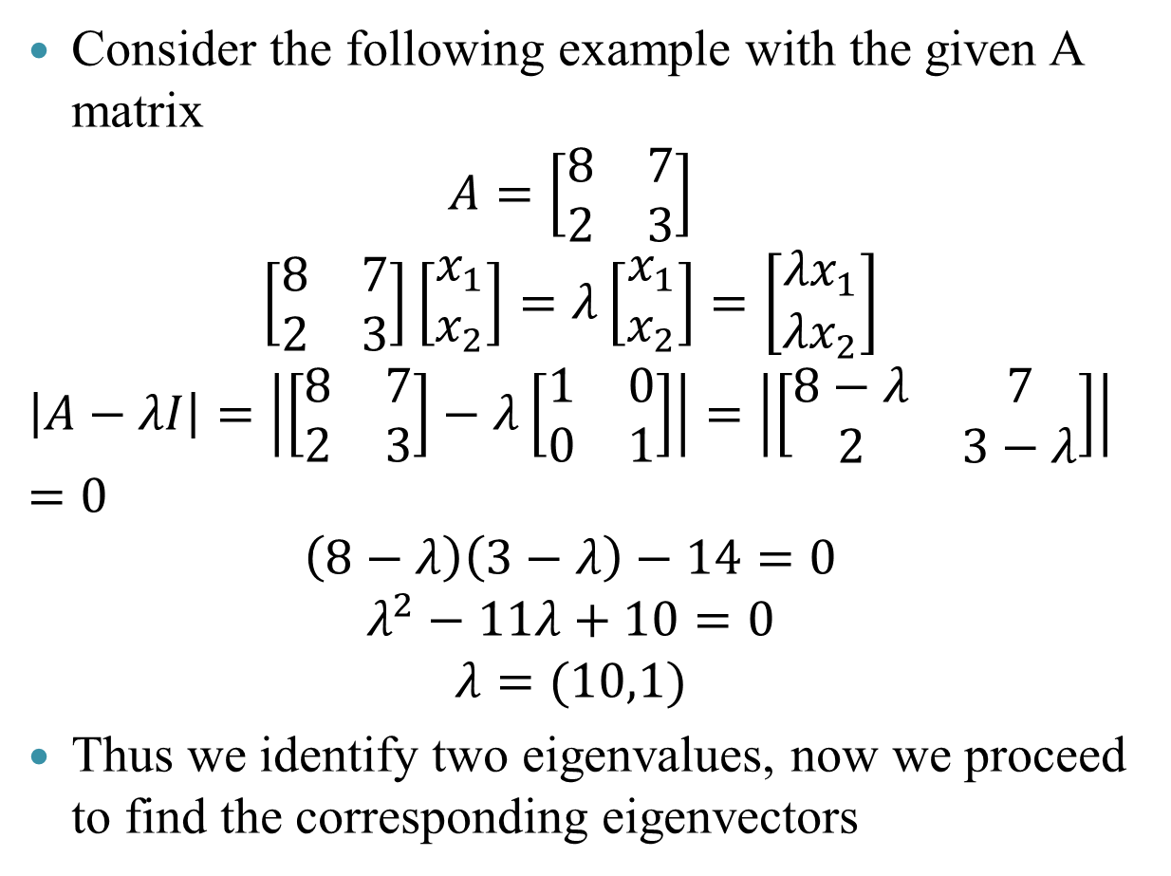
Eigenvalues and eigenvectors: Examples
Consider the following example with the given A matrix
$$A=\left[\begin{matrix}8 & 7 \\ 2 & 3\end{matrix}\right]$$
$$\left[\begin{matrix}8 & 7 \\ 2 & 3\end{matrix}\right]\left[\begin{aligned}x_{1} \\ x_{2}\end{aligned}\right]=λ\left[\begin{aligned}x_{1} \\ x_{2}\end{aligned}\right]=\left[\begin{aligned}{λx}_{1} \\ {λx}_{2}\end{aligned}\right]$$
$$\left|A−λI\right|=\left|\left[\begin{matrix}8 & 7 \\ 2 & 3\end{matrix}\right]−λ\left[\begin{matrix}1 & 0 \\ 0 & 1\end{matrix}\right]\right|=\left|\left[\begin{matrix}8−λ & 7 \\ 2 & 3−λ\end{matrix}\right]\right|=0$$
$$\left(8−λ\right)\left(3−λ\right)−14=0$$
$$λ^{2}−11λ+10=0$$
$$λ=(10,1)$$
Thus we identify two eigenvalues, now we proceed to find the corresponding eigenvectors
R Code
A = matrix(c(8,7,2,3), 2, 2, byrow=TRUE)
ev =eigen(A)
values = ev$values
Console output
> values
[1] 10 1

Slide 24
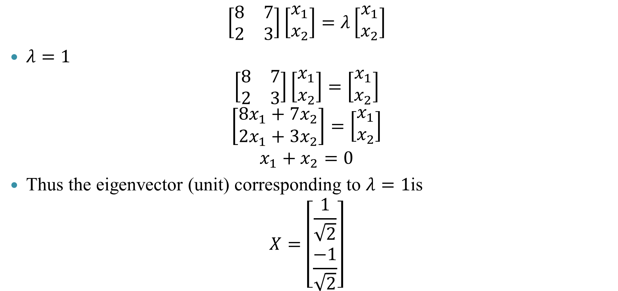
Eigenvalues and eigenvectors: Examples
$$\left[\begin{matrix}8 & 7 \\ 2 & 3\end{matrix}\right]\left[\begin{aligned}x_{1} \\ x_{2}\end{aligned}\right]=λ\left[\begin{aligned}x_{1} \\ x_{2}\end{aligned}\right]$$
$λ=1$
$$\left[\begin{matrix}8 & 7 \\ 2 & 3\end{matrix}\right]\left[\begin{aligned}x_{1} \\ x_{2}\end{aligned}\right]=\left[\begin{aligned}x_{1} \\ x_{2}\end{aligned}\right]$$
$$\left[\begin{aligned}{8x}_{1}+7x_{2} \\ 2x_{1}+3x_{2}\end{aligned}\right]=\left[\begin{aligned}x_{1} \\ x_{2}\end{aligned}\right]$$
$$x_{1}+x_{2}=0$$
Thus the eigenvector (unit) corresponding to $λ=1$is
$$X=\left[\begin{aligned}\frac{1}{\sqrt{2}} \\ \frac{−1}{\sqrt{2}}\end{aligned}\right]$$

Slide 25
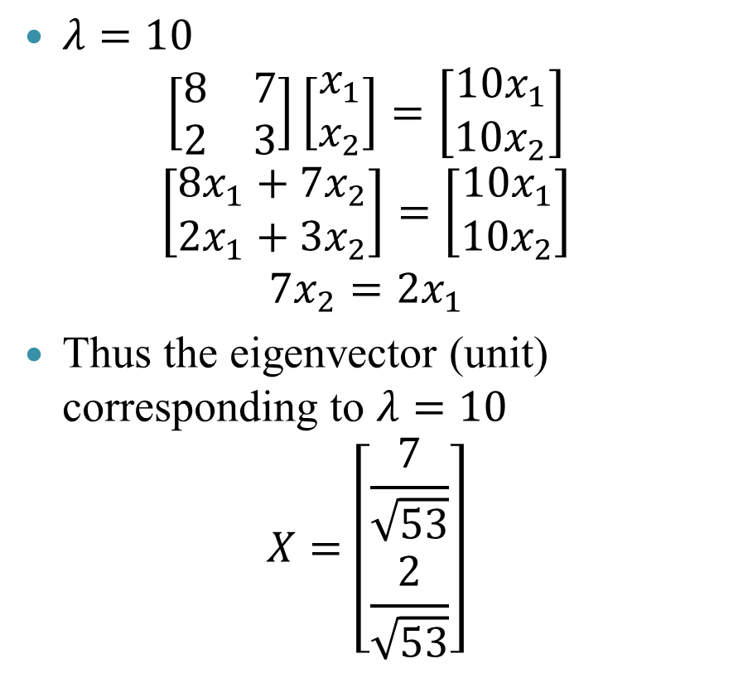
Eigenvalues and eigenvectors: Examples
$λ=10$
$$\left[\begin{matrix}8 & 7 \\ 2 & 3\end{matrix}\right]\left[\begin{aligned}x_{1} \\ x_{2}\end{aligned}\right]=\left[\begin{aligned}{10x}_{1} \\ {10x}_{2}\end{aligned}\right]$$
$$\left[\begin{aligned}{8x}_{1}+7x_{2} \\ 2x_{1}+3x_{2}\end{aligned}\right]=\left[\begin{aligned}10x_{1} \\ {10x}_{2}\end{aligned}\right]$$
$$7x_{2}=2x_{1}$$
Thus the eigenvector (unit) corresponding to $λ=10$
$$X=\left[\begin{aligned}\frac{7}{\sqrt{53}} \\ \frac{2}{\sqrt{53}}\end{aligned}\right]$$
R Code
A = matrix(c(8,7,2,3), 2, 2, byrow=TRUE)
ev =eigen(A)
vectors <- ev$vectors
> vectors
[,1] [,2]
[1,] 0.9615239 -0.7071068
[2,] 0.2747211 0.7071068

Slide 26
Summary
$$Ax=b$$
𝐴𝑥=𝑏
Geometrically interpreted as the rotation of a matrix $x$ to $b$ due to the operator $A$
Geometrically interpreted as the rotation of a matrix 𝑥 to 𝑏 due to the operator 𝐴
$$Ax=λx$$
𝐴𝑥=𝜆𝑥
Eigenvalue-eigenvector equation
$$λ$$
𝜆
$$x$$
𝑥
N eigenvalues from $\left|A−λI\right|=0$
N eigenvalues from |𝐴−𝜆𝐼|=0
Eigenvectors, generally expressed in unit vector form

